Slide 1


PROJECT CSE 310
JAVA PROGRAMMING

Slide 2

GROUP MEMBERS-
Rakshit Shekhawat
Jay Khaple
Abhiram Reddy

Slide 3



Inventory Management System-
An inventory management system is a software or tool designed to efficiently track, manage, and control a company's inventory. It provides businesses with real-time visibility into their inventory levels, allowing them to effectively monitor and optimize their inventory operations. The primary goal of an inventory management system is to ensure that businesses have the right amount of inventory at the right time, reducing stockouts, minimizing overstocking, and improving overall operational efficiency.

Slide 4

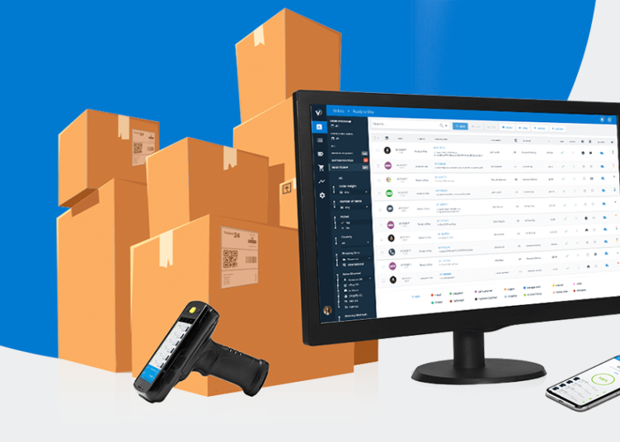
Summary-
In our project we have created a inventory management system for the military. Here we created three different classes for all three forces – Airforce , Navy and Army. With the help of this management system we can manage the information about the weapon , required things and be updated accordingly.
This Photo by Unknown Author is licensed under CC BY-SA-NC

Slide 5
Code description-
It is a Java program for a military inventory management system.
The code consists of multiple classes representing different branches of the military (Army, Navy, Airforce) and an inventory management class.
The program allows users to perform various operations such as displaying inventory, updating inventory quantities, and managing inventory files.
We have used try catch function for IO exception, We have used inheritance here also we have used file handling here.

Slide 6
Main Function
It serves as the entry point of the program.
Creates instances of the Army, Navy, and Airforce classes for inventory management.
Prompts the user for the number of inputs they want to perform.
Uses a loop to iterate over the inputs and presents a menu of options to the user.
Based on the user's selection, it calls the respective methods to display or update the inventory.

Slide 7
Inventory Class
It serves as the base class for the Army, Navy, and Airforce classes.
Contains the common attributes guns and vest representing the inventory quantities.
The read method for reading and displaying the inventory from a file.
The update method for updating the inventory quantities and saving the changes to a file.

Slide 8
Army, Navy, and Airforce Classes
Each class extends the Inventory class, inheriting its attributes and methods.
They override the read and update methods to provide branch-specific functionality.
The read method reads and displays the inventory from the respective branch's file.
The update method allows the user to update the inventory quantities for the specific branch and saves the changes to the file.

Slide 9
File Handling
Files named "Army.txt," "Navy.txt," and "Airforce.txt" are used to store the inventory data for each branch.
The read method reads the inventory data from the respective file and displays it.
The update method updates the inventory quantities provided by the user and saves the changes to the file.

Slide 10
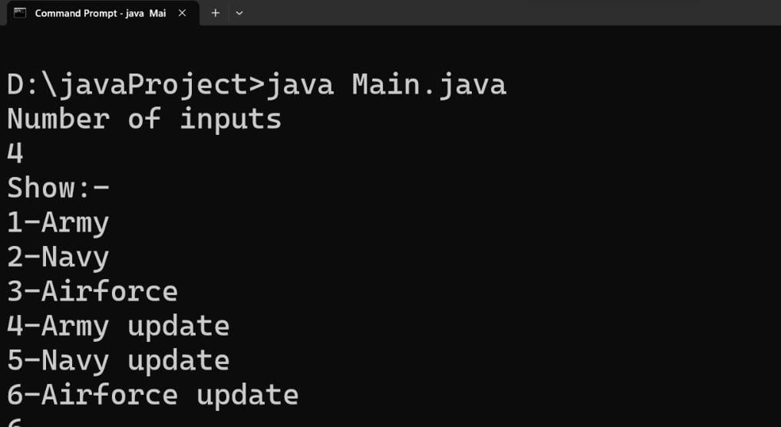
Output- for selection

Slide 11
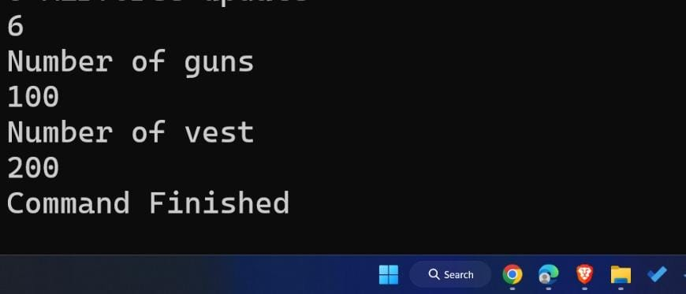
Output- for view the quantity

Slide 12
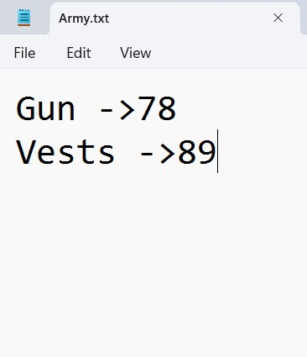
Output- for file handling

Slide 13
Conclusion-
The military inventory management system is implemented in Java.
It allows real-time tracking and management of inventories for the Army, Navy, and Airforce.
The program provides options to display and update inventory quantities.
File handling is used to store and retrieve inventory data.
The system helps improve inventory control and operational efficiency in the military.

Slide 14

Thank you

